Slide 1
Blind Walking Stick Using Arduino & Ultrasonic Sensor
Hancis Bogdan
Gheorghita Rares
Group 2023

Slide 2
In this project, we will learn how to design Blind Walking Stick Using Arduino & Ultrasonic Sensor HC-SR04. Almost 30 million people are blind according to the recent WHO Report. These blind people are totally dependent on others as they can’t walk alone. This is the reason why we have designed the Blind Walking Stick device which will help blind people to walk with ease independently.

Slide 3
Components Required:
1. Arduino UNO Board 2. HC-SR04 Ultrasonic Sensor 3. Buzzer 4. 9 Volt Battery 5. Switch (Optional)

Slide 4
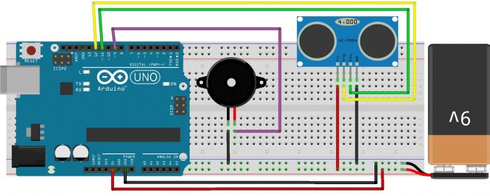
Circuit

Slide 5
The main objective of this project is to help blind people to walk with ease and to be warned whenever their walking path is obstructed by obstacles. As a warning signal via buzzer, whose frequency of beep changes according to the distance of the object. The closer the distance of obstruction, the more will be the buzzer beep frequency.
The main component used for this device is the Ultrasonic Sensor HC-SR04. The ultrasonic sensor transmits a high frequency sound pulse and then calculates the time to receive the signal of the sound echo to reflect back. HC-SR04 has a transmitter & receiver surface. One of them acts as the transmitter and transmits the ultrasonic waves. The other one acts as a receiver and receives the echoed sound signal. The sensor is calibrated according to the speed of the sound in air. The speed of sound is 341 meters per second in the air, and the distance between the sensor and object is equal to time multiplied by the speed of sound divided by two.

Slide 7
Source Code
int trigPin = 10;
int echoPin = 11;
int buzzer = 9;
long duration;
int distance;
void setup() {
pinMode(trigPin,OUTPUT);
pinMode(echoPin,INPUT);
pinMode(buzzer,OUTPUT);
Serial.begin(9600);
}
void loop() {
// send the signal
digitalWrite(trigPin,LOW);
delayMicroseconds(2);
digitalWrite(trigPin,HIGH);
delayMicroseconds(10);
digitalWrite(trigPin,LOW);
duration = pulseIn(echoPin,HIGH); // read the reflected waves
distance = duration * 0.034 / 2; // compute the distance
Serial.print("Distance: ");
Serial.println(distance);
// make sound effect
if(distance < 100) {
int del = 2 * distance; // delay in milliseconds
digitalWrite(buzzer,HIGH);
delay(del);
digitalWrite(buzzer,LOW);
delay(del);
}
}

Slide 8
Thank you !

